Slide 1










Branding concerns and issues
1. Stay on brand
Brand Control
Content Creation
Content
Enablement

Slide 2
How can I ensure users stay on brand and use the correct templates, fonts and colors?
Q

Slide 3

Ctrl click
to watch our
‘how to’ video on empower® branding tools

Slide 4




Four tools to protect and promote your brand
1
1
1
1
1
2
3
4
Master
templates
Branded
formatting tools
Design
asset library
Design
check

Slide 5
empower tools that can help with branding | 1 of 4
Master templates folder
Multiple template options
Accessible directly in PowerPoint
Folder structure and
permission model
Master templates
Default template, launches
as you open PowerPoint
Easy to update and distribute
→
A well-designed template is key for effective brand protection
and simplifies the presentation creation process.
Notes:
Multiple template options
To support sub-brands and variants
Accessible directly in PowerPoint
Easy to distribute and update, also incudes version history
Folder structure and permission model
Allows user-specific access to templates
Default template, launches as you open PowerPoint
Set your most used template as your default (and can be changed as required by users)
Easy to update and distribute
Email us your new version to upload and users will automatically have access to the new template

Slide 6
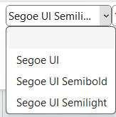
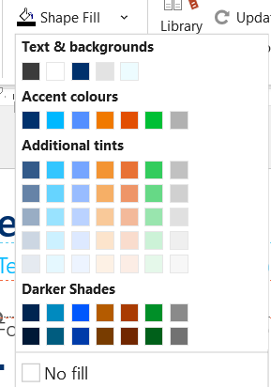
empower tools that can help with branding | 2 of 4
Template specific branded formatting tools
Formatting tools set with your brand defaults
  Controlled font list
  Controlled color pickers (with headings to instruct)
  Applies template bullets
→
A well-designed template is key for effective brand protection
and simplifies the presentation creation process.

Slide 7
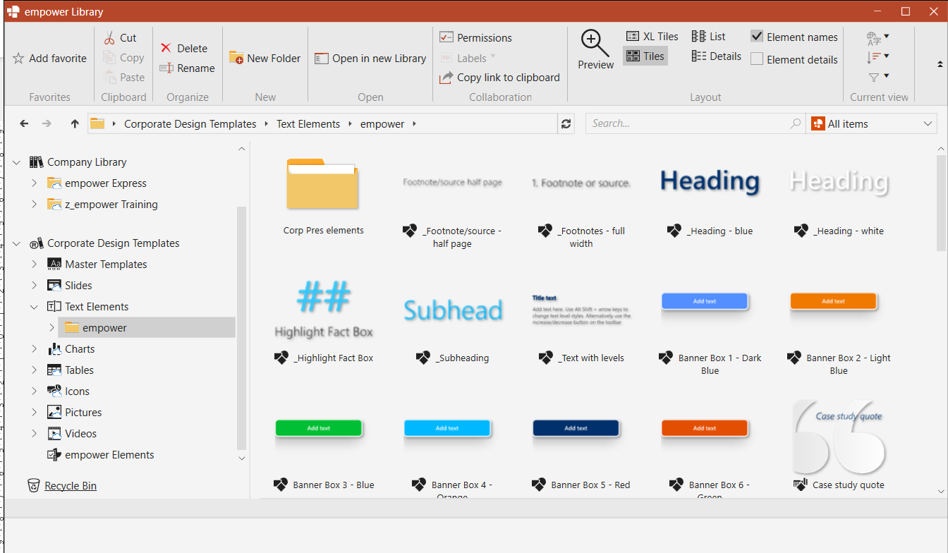
empower tools that can help with branding | 3 of 4
Design assets library
Create a library of assets
  Accessible directly in PowerPoint (incl. versions)
  Folder structure and adaptable permission model
  Library of objects, slide layouts and
  approved content and collateral
  Easily updated and instantly pushed out to users
  Easy to upload and create your library
→
More information about how to create a brand assets library is available in a further tutorial
– Brand asset library
Notes:
All accessible directly in PowerPoint (incl. versions)
Can be organized by folder structure and
permissioned to allow user-specific access to content
Can create a library of objects, slide layouts and
approved content and collateral
Can be updated easily – instant push out to users
Easy to upload and create your library

Slide 8
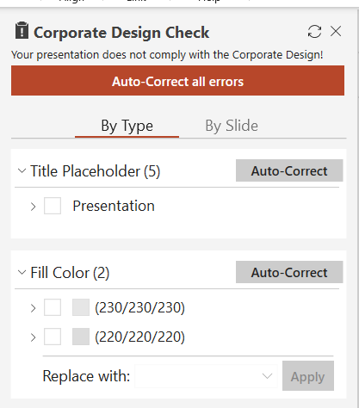
empower tools that can help with branding | 4 of 4
Design check
✓
Check title placeholder
✓
Check color
✓
Check fonts
✓
Check bullets

Slide 9
    Contact us about:
    Your template and brand design set up
    Reviewing, building or designing a template
    Setting up your library
→
Email us on info@empower.express
→
Book at call with our design team
→
Book at call with our training team

Slide 10
Email us on info@empower.express

Slide 11
Next steps for learning
Additional videos and information
  Introduction to empower
  Toolbar overview
  Functionality overview
  What makes a good template
  Setting up libraries - detail
  Saving content to the library (including bulk uploading)
  Using libraries
  The design check
  Link to full manual
  Any other useful videos
To be updated
Add links to other useful training content once complete

Slide 12
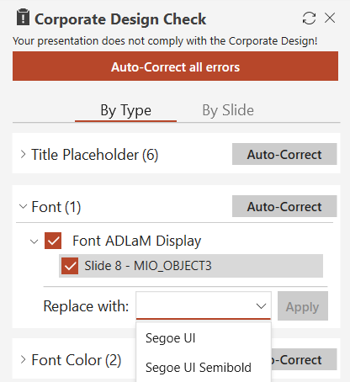
This slide is to test the design check tool
This is a subhead with the wrong color blue – run the design check tool and correct the formats
✗
Placeholder issues
✗
Wrong color
✗
Wrong fonts
✗
Wrong bullets

Slide 13
This is a slide to test out ‘Apply formats’
Restyle to the correct brand format
Heading box – wrong color, style, format, size and postiion
Costs | PLANNED EXPENSES | ACTUAL EXPENSES | VARIANCE | VARIANCE %
Employee Costs | 15,000.00 | 70,000.00 | 55,000.00 | 366.67%
Office Costs | 100,000.00 | 70,000.00 | -30,000.00 | -30.00%
Marketing Costs | 30,000.00 | 50,000.00 | 20,000.00 | 66.67%
Training / Travel | 20,000.00 | 25,000.00 | 5,000.00 | 25.00%
 | 165,000.00 | 215,000.00 | 50,000.00 | 30.30%
NOTE: this footnote text comes from excel and it is in the wrong position and the wrong format – apply the correct format and position from the text elements.

